Slide 1
Restricted Boltzmann Machine
Sungjoon Choi

Slide 2
Boltzmann Machine
A Boltzmann machine is a network whose elements consist of 0 and 1 (binary units).

Slide 3
Restricted Boltzmann Machine
A restricted Boltzmann machine restricts connections between visible and hidden nodes.

Slide 4
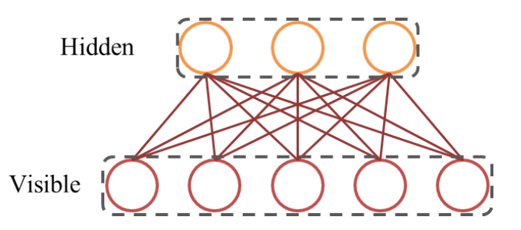
Restricted Boltzmann Machine

Slide 5
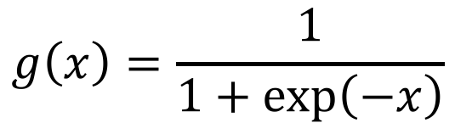
Energy
The distribution of an RBM is specified as:
$E\left(v, h | θ\right)=−\sum_{i=1}^{D}{\sum_{j=1}^{F}{w_{ij}v_{i}h_{j}}}−\sum_{i=1}^{D}{b_{i}v_{i}}−\sum_{j=1}^{F}{a_{j}h_{j}}$
The conditional distribution of the hidden vector given vision vector is specified as:
$p\left(h_{j}=1|v\right)=g\left(\sum_{i}{W_{ij}v_{i}+a_{j}}\right)$
$p\left(v_{i}=1|h\right)=g\left(\sum_{j}{W_{ij}h_{h}+b_{j}}\right)$
$$g\left(x\right)=\frac{1}{1+\exp\left(−x\right)}$$

Slide 6
Deep Belief Network (DBN)
A DBN simply stacks RBM, level by level.
Training is done in a layer-wise manner.
It is an unsupervised learning method.
DBN had been widely used as a pre-training method until 2014..

Slide 7
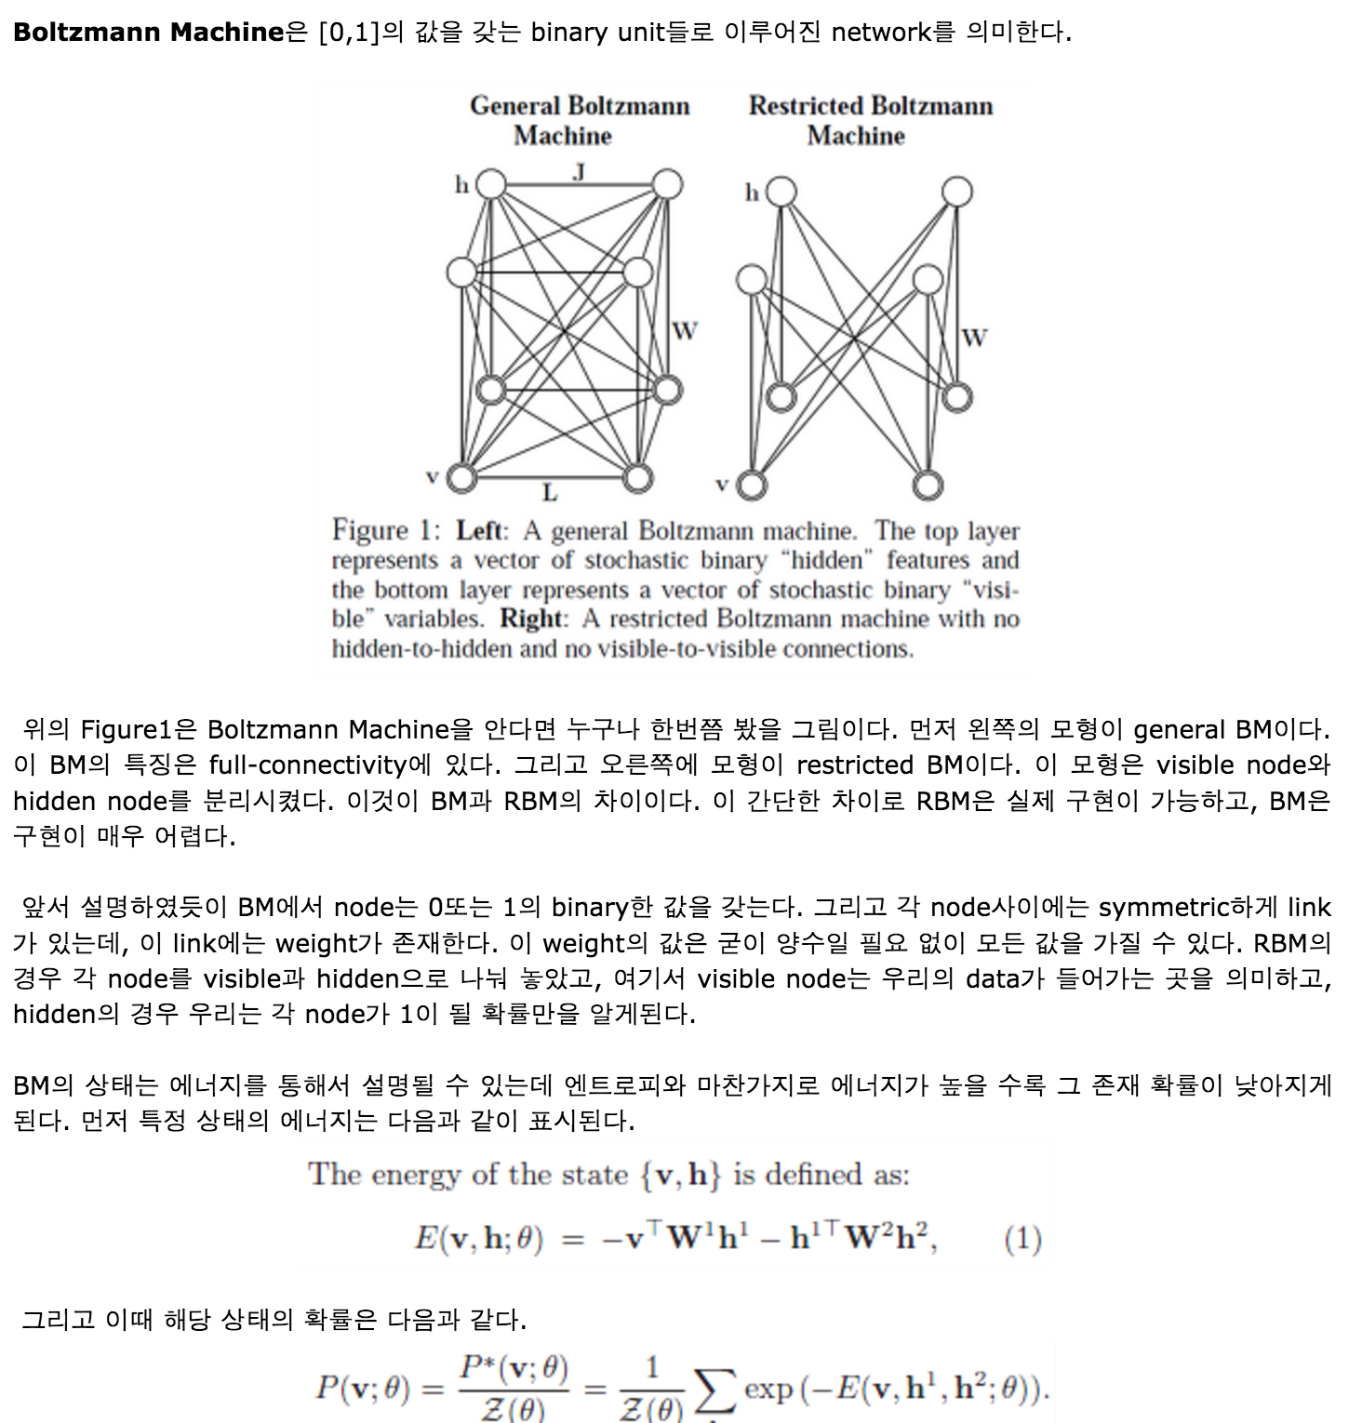
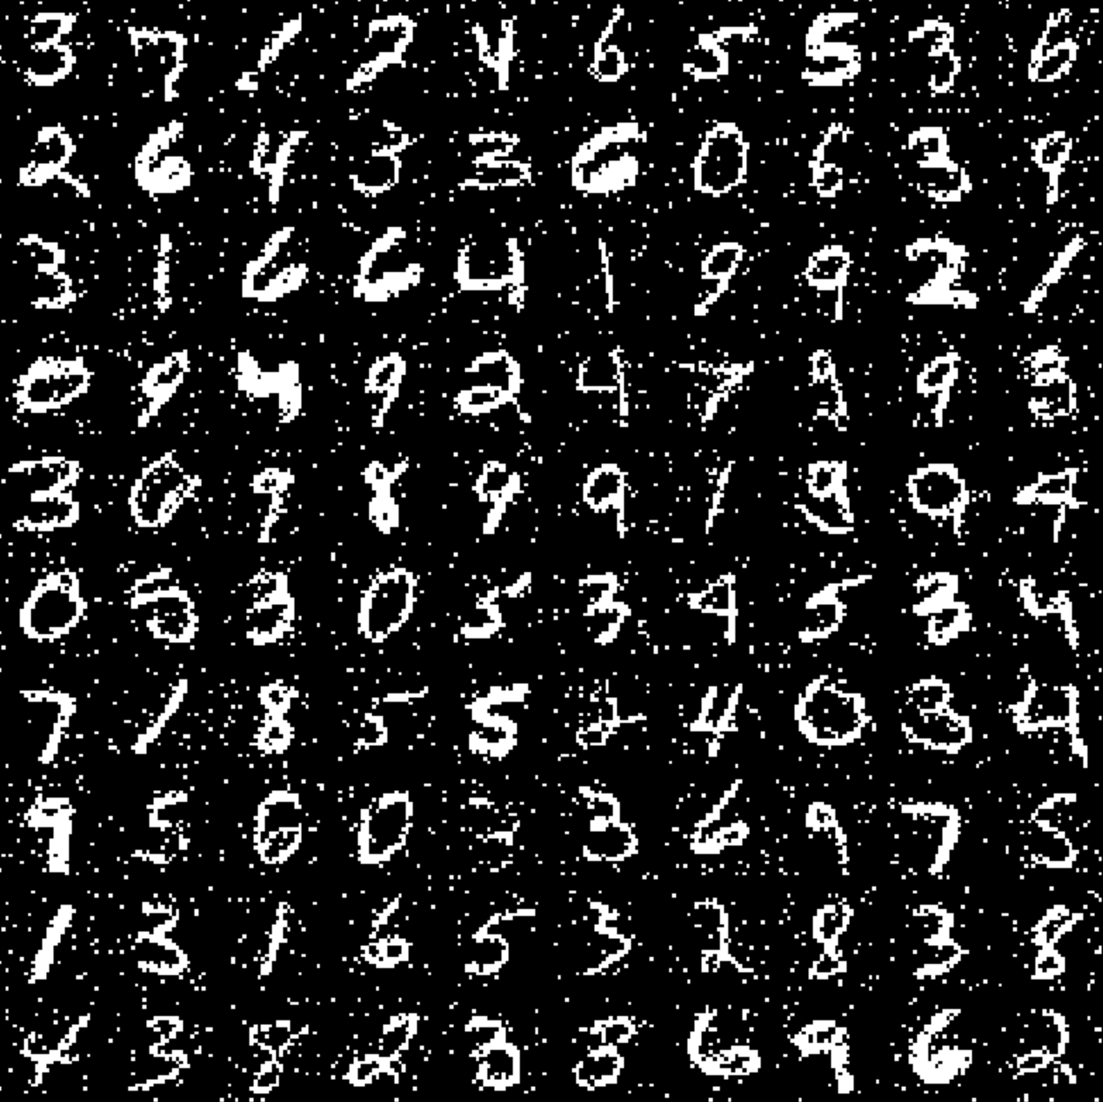
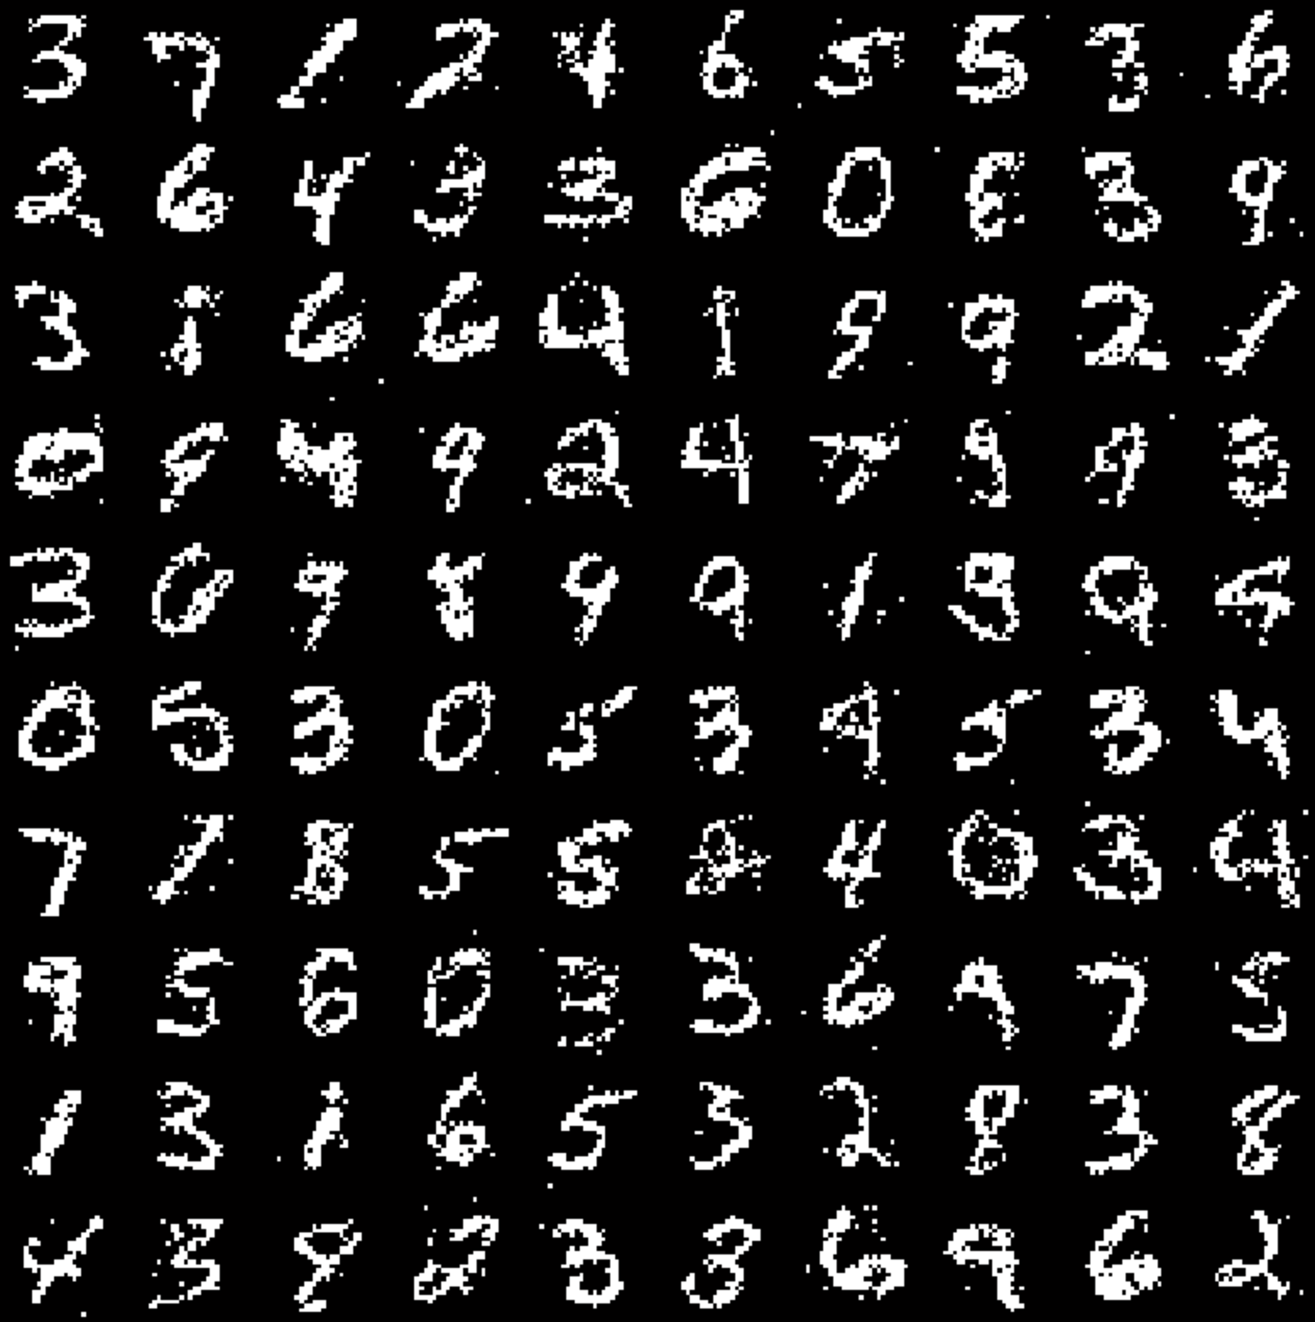
If you are further interested,
http://enginius.tistory.com/315

Slide 8
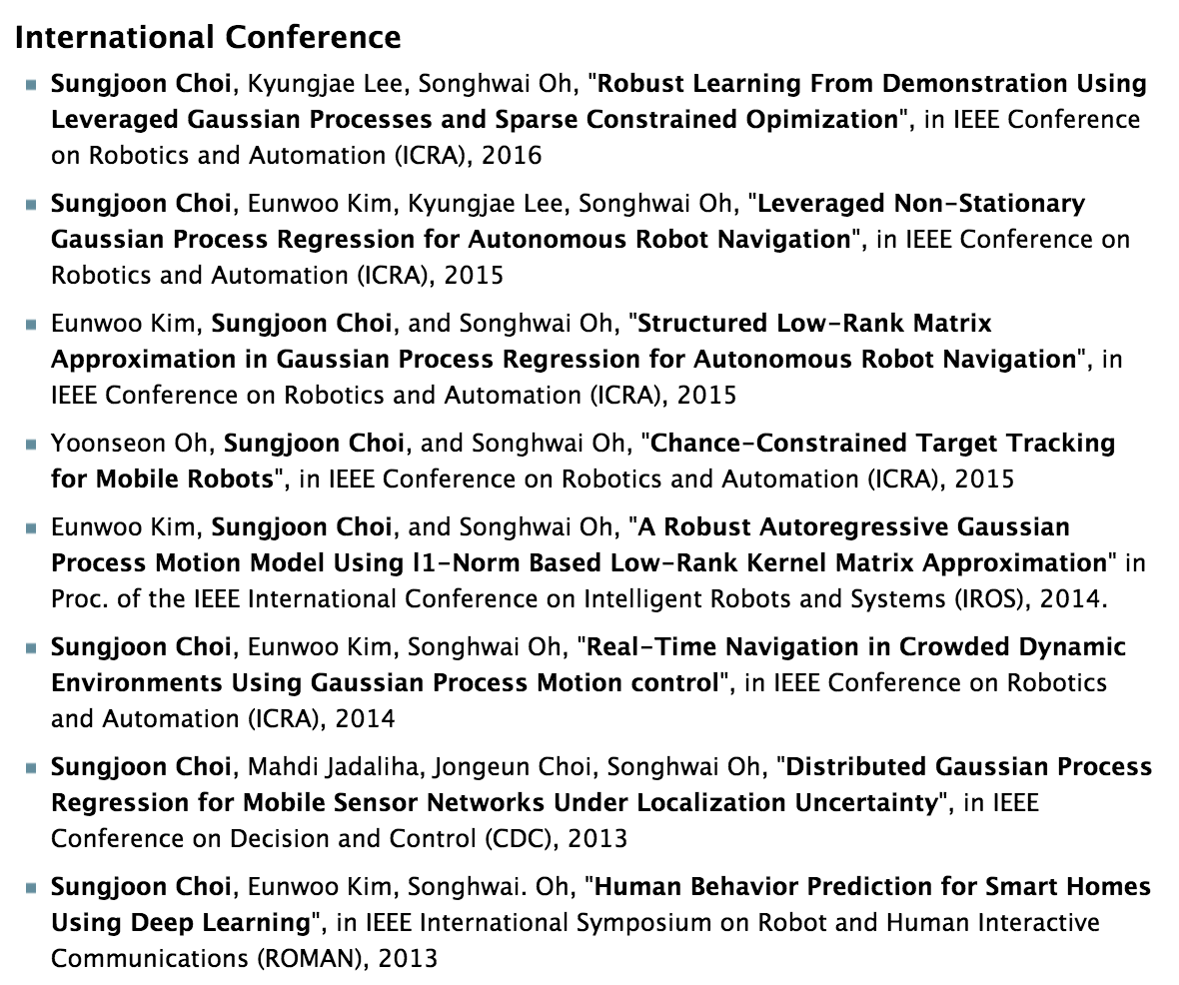
My first paper,
Sungjoon Choi, Eunwoo Kim, Songhwai Oh, “Human Behavior Prediction for Smart Homes Using Deep Leering”, ROMAN, 2013

Slide 9
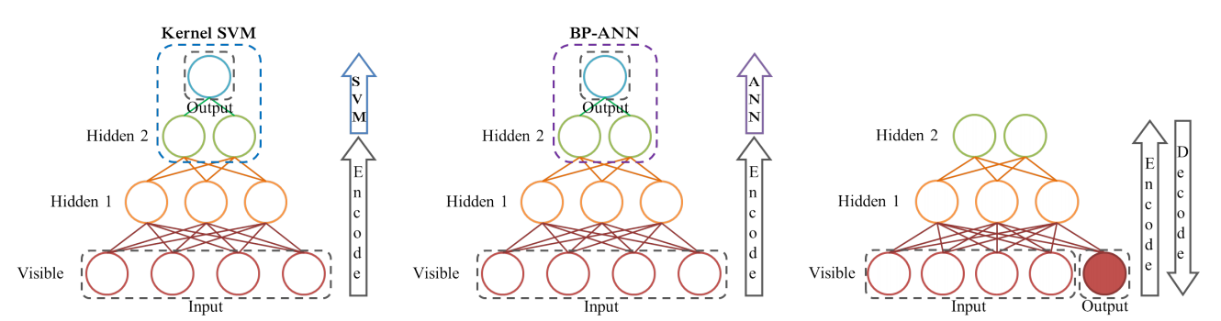
DBN-Reconstruct

Slide 10
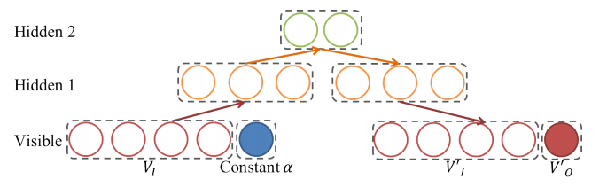
DBN-Reconstruct

Slide 11
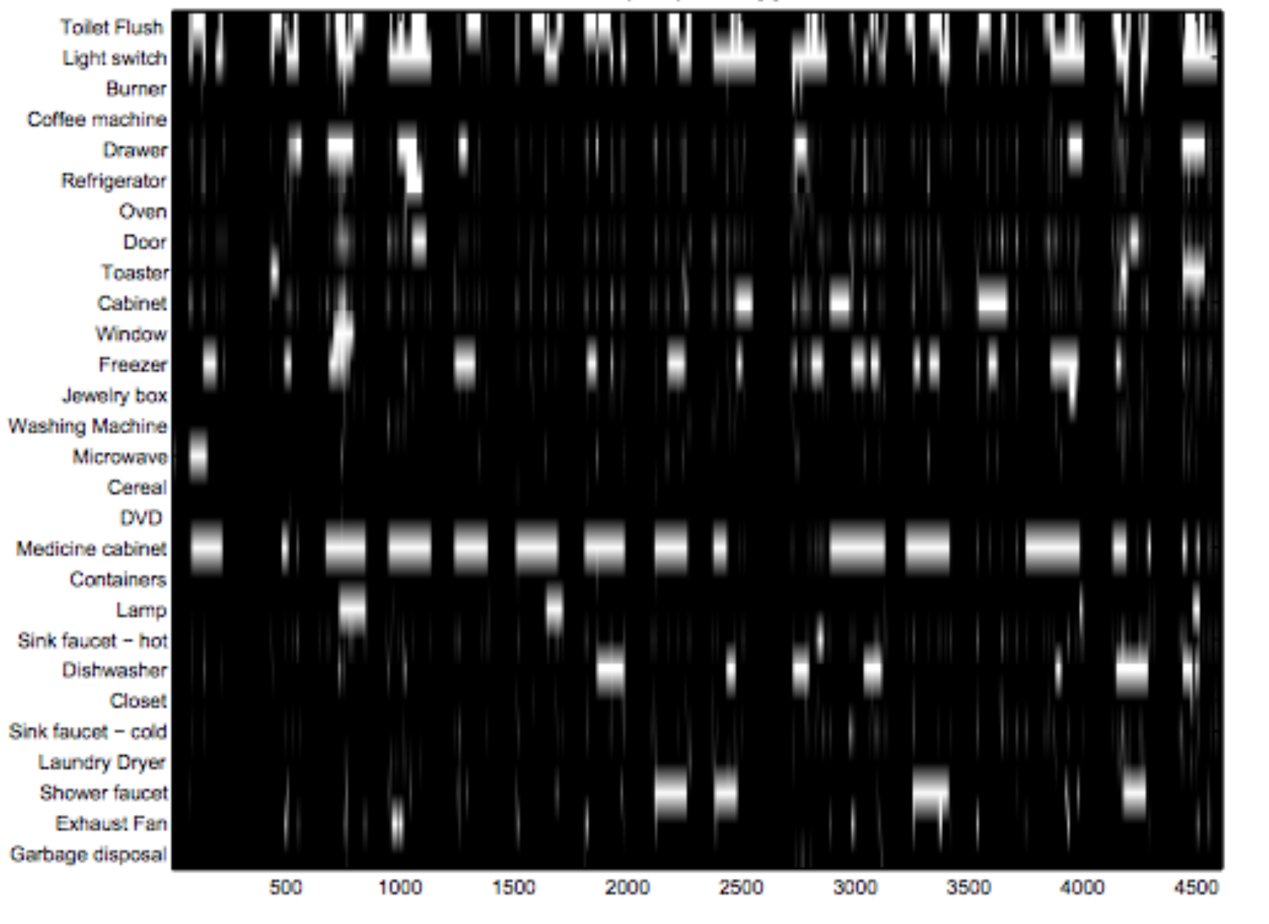
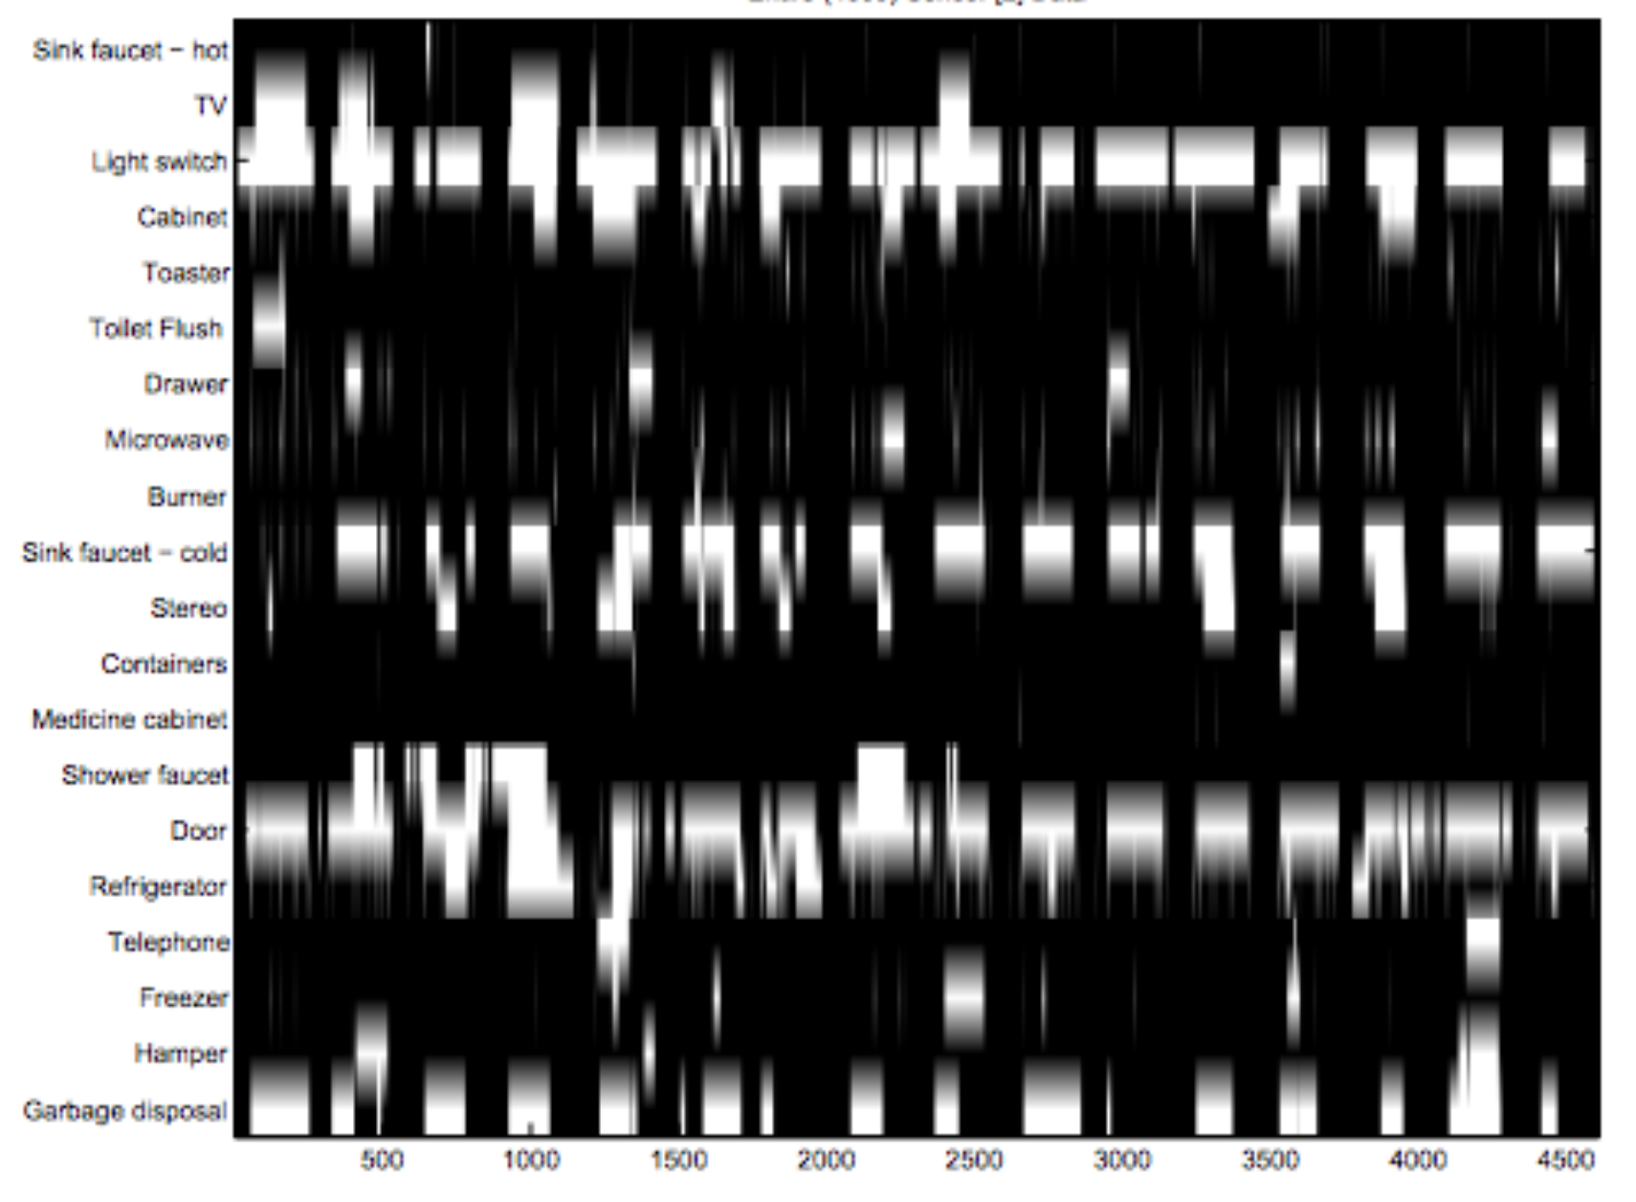
Use to predict Home Dataset

Slide 12
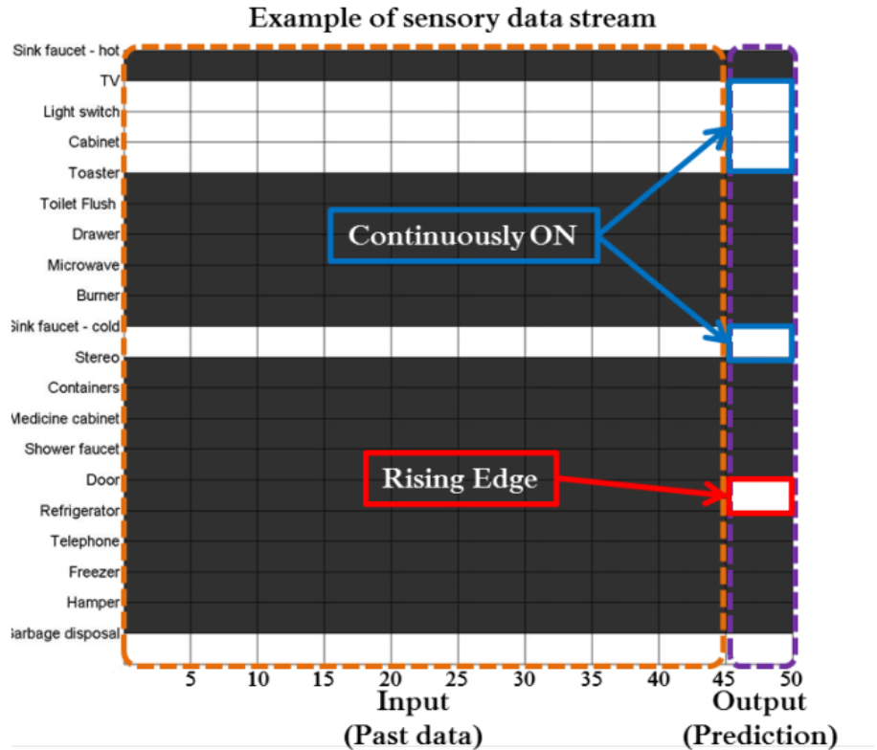
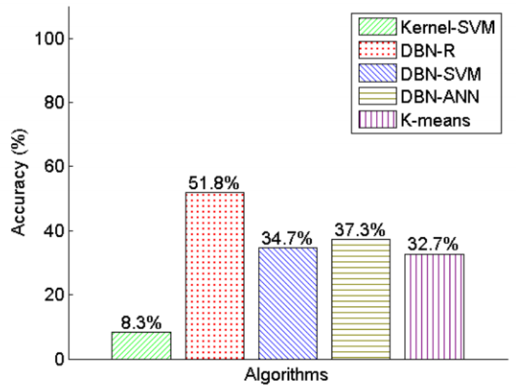
Result

